Slide 1
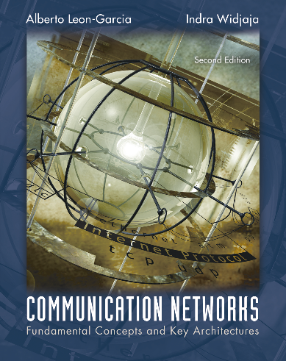
Medium Access Control Protocols
Multiple Access Communications
Random Access
Scheduling

Slide 2
Medium Access Control Protocols
Multiple Access Communications

Slide 3
MAC sublayer
In networks with shared medium, data link layer is divided into two sublayers
LLC – Logical link Control
MAC – Medium Access Control
application
transport
network
link
physical
LLC
MAC

Slide 4
Multiple Access Communications
Shared media basis for broadcast networks
Inexpensive: radio over air; copper or coaxial cable
M users communicate by broadcasting into medium
Key issue: How to share the medium?
3
2
4
1
Shared multiple
access medium
M
5
…

Slide 5
Approaches to Media Sharing
Medium sharing techniques
Static channelization
Dynamic medium access control
Partition medium
Dedicated allocation to users
Satellite transmission
Cellular Telephone
Scheduling
Random access
Polling: take turns
Request for slot in transmission schedule
Token ring
Wireless LAN
Loose coordination
Send, wait, retry if necessary
Aloha
Ethernet, Wireless LAN

Slide 6
Scheduling: Polling
Inbound line
Data from 1
Data from 2
Poll 1
Poll 2
Data to M
Outbound line
Host
computer
1
2
3
M
Stations

Slide 7
Scheduling: Token-Passing
Ring networks
token
Data to M
token
Station that holds token transmits into ring

Slide 8
Random Access
Multitapped Bus
Crash!!
Transmit when ready
Collisions can occur; need retransmission strategy

Slide 9
Wireless LAN
AdHoc: station-to-station
Infrastructure: stations to access point
Random access & polling

Slide 10
Delay-Bandwidth Product
Delay-bandwidth product key parameter
Coordination in sharing medium involves using bandwidth (explicitly or implicitly)
Difficulty of coordination commensurate with delay-bandwidth product
Simple two-station example
Station with frame to send listens to medium and transmits if medium found idle
Station monitors medium to detect collision
If collision occurs, station that begin transmitting earlier retransmits (propagation time is known)

Slide 11
Two-Station MAC Example
Two stations are trying to share a common medium
Distance d meters
t_{prop} = d / ν seconds
A transmits at t = 0
A
B
Case 1
B does not transmit before t = t_{prop} & A captures channel
A
B
Case 2
B transmits before t = t_{prop} and detects collision soon
thereafter
A
B
A detects
collision at
t = 2 t_{prop}
A
B

Slide 12
Efficiency of Two-Station Example
Each frame transmission requires 2t_{prop} of quiet time
Station B needs to be quiet t_{prop} before and after time when Station A transmits
R transmission bit rate
L bits/frame
Normalized Delay-Bandwidth Product
Propagation delay
Time to transmit a frame

Slide 13
Typical MAC Efficiencies
Two-Station Example:
If a<<1, then efficiency close to 100%
As a approaches 1, the efficiency becomes low
CSMA-CD (Ethernet) protocol:
Token-ring network
a΄= latency of the ring (bits)/average frame length

Slide 14
Typical Delay-Bandwidth Products
Distance | 10 Mbps | 100 Mbps | 1 Gbps | Network Type
1 m | 3.33 x 10⁻⁰² | 3.33 x 10⁻⁰¹ | 3.33 x 10⁰ | Desk area network
100 m | 3.33 x 10⁰¹ | 3.33 x 10⁰² | 3.33 x 10⁰³ | Local area network
10 km | 3.33 x 10⁰² | 3.33 x 10⁰³ | 3.33 x 10⁰⁴ | Metropolitan area network
1000 km | 3.33 x 10⁰⁴ | 3.33 x 10⁰⁵ | 3.33 x 10⁰⁶ | Wide area network
100000 km | 3.33 x 10⁰⁶ | 3.33 x 10⁰⁷ | 3.33 x 10⁰⁸ | Global area network
Max size Ethernet frame: 1500 bytes = 12000 bits
Long and/or fat pipes give large a

Slide 15
MAC Performance
Frame transfer delay
From first bit of frame arrives at source MAC
To last bit of frame delivered at destination MAC
Throughput
Actual transfer rate through the shared medium
Measured in frames/sec or bits/sec
Parameters
R bits/sec & L bits/frame
X=L/R seconds/frame
λ frames/second average arrival rate
Load ρ = λ X, rate at which “work” arrives
Maximum throughput (@100% efficiency): R/L fr/sec

Slide 16
Normalized Delay versus Load
E[T]/X
E[T] = average frame
transfer delay
At low arrival rate, only frame transmission time
At high arrival rates, increasingly longer waits to access channel
Max efficiency typically less than 100%
X = average frame
transmission time
Transfer delay
1
ρ
ρ_{max}
1
Load

Slide 17
Dependence on Rt_{prop}/L
E[T]/X
a′ > a
a′
a
Transfer Delay
1
ρ
ρ′_{max}
ρ_{max}
1
Load

Slide 18
Random Access

Slide 19
ALOHA
Wireless link to provide data transfer between main campus & remote campuses of University of Hawaii
Simplest solution: just do it
A station transmits whenever it has data to transmit
If more than one frames are transmitted, they interfere with each other (collide) and are lost
If ACK not received within timeout, then a station picks random backoff time (to avoid repeated collision)
Station retransmits frame after backoff time
First transmission
Retransmission
Backoff period B
t
t₀-X
t₀
t₀+X
t₀+X+2t_{prop}
t₀+X+2t_{prop} + B
Vulnerable
period
Time-out

Slide 20
ALOHA Model
Definitions and assumptions
X frame transmission time (assume constant)
S: throughput (average # successful frame transmissions per X seconds)
G: load (average # transmission attempts per X sec.)
P_{success} : probability a frame transmission is successful
Any transmission that begins during vulnerable period leads to collision
Success if no arrivals during 2X seconds
X
X
Prior interval
frame transmission

Slide 21
Abramson’s Assumption
What is probability of no arrivals in vulnerable period?
Abramson assumption: Effect of backoff algorithm is that frame arrivals are equally likely to occur at any time interval
G is avg. # arrivals per X seconds
Divide X into n intervals of duration Δ=X/n
p = probability of arrival in Δ interval, then
G = n p since there are n intervals in X seconds

Slide 22
Throughput of ALOHA
Collisions are means for coordinating access
Max throughput is ρ_{max}= 1/2e (18.4%)
Bimodal behavior:
Small G, S≈G
Large G, S↓0
Collisions can snowball and drop throughput to zero
(2e)⁻¹ = 0.184

Slide 23
Slotted ALOHA
Time is slotted in X seconds slots
Stations synchronized to frame times
Stations transmit frames in first slot after frame arrival
Backoff intervals in multiples of slots
Backoff period B
t
kX
(k+1)X
t₀ +X+2t_{prop}
t₀ +X+2t_{prop}+ B
Vulnerableperiod
Time-out
Only frames that arrive during prior X seconds collide

Slide 24
Throughput of Slotted ALOHA
0.368
S
Ge^{-G}
0.184
Ge^{-2G}
G

Slide 25
Application of Slotted Aloha
cycle
. . .
. . .
Reservation mini-slots
X-second slot
Reservation protocol allows a large number of stations with infrequent traffic to reserve slots to transmit their frames in future cycles
Each cycle has mini-slots allocated for making reservations
Stations use slotted Aloha during mini-slots to request slots

Slide 26
Carrier Sensing Multiple Access (CSMA)
A station senses the channel before it starts transmission
If busy, either wait or schedule backoff (different options)
If idle, start transmission
Vulnerable period is reduced to t_{prop} (due to channel capture effect)
When collisions occur they involve entire frame transmission times
If t_{prop} >X (or if a>1), no gain compared to ALOHA or slotted ALOHA
Station A begins transmission at t = 0
A
Station A captures
channel at t = t_{prop}
A

Slide 27
CSMA Options
Transmitter behavior when busy channel is sensed
1-persistent CSMA (most greedy)
Start transmission as soon as the channel becomes idle
Low delay and low efficiency
Non-persistent CSMA (least greedy)
Wait a backoff period, then sense carrier again
High delay and high efficiency
p-persistent CSMA (adjustable greedy)
Wait till channel becomes idle, transmit with prob. p; or wait one mini-slot time & re-sense with probability 1-p
Delay and efficiency can be balanced
Sensing

Slide 28
1-Persistent CSMA Throughput
S
0.53
Better than Aloha & slotted Aloha for small a
Worse than Aloha for a > 1
a = 0.01
0.45
0.16
a =0.1
G
a = 1

Slide 29
Non-Persistent CSMA Throughput
a = 0.01
S
0.81
Higher maximum throughput than 1-persistent for small a
Worse than Aloha for a > 1
0.51
a = 0.1
0.14
G
a = 1

Slide 30
CSMA with Collision Detection (CSMA/CD)
Monitor for collisions & abort transmission
Stations with frames to send, first do carrier sensing
After beginning transmissions, stations continue listening to the medium to detect collisions
If collisions detected, all stations involved stop transmission, reschedule random backoff times, and try again at scheduled times
In CSMA collisions result in wastage of X seconds spent transmitting an entire frame
CSMA-CD reduces wastage to time to detect collision and abort transmission

Slide 31
CSMA/CD reaction time
A begins to
transmit at
t = 0
A
B
B begins to
transmit at
t = t_{prop}- δ; 
B detects
collision at
t = t_{prop}
A
B
A detects
collision at
t= 2 t_{prop}- δ
A
B
It takes 2 t_{prop} to find out if channel has been captured

Slide 32
CSMA-CD Model
Assumptions
Collisions can be detected and resolved in 2t_{prop}
Time slotted in 2t_{prop} slots during contention periods
Assume n busy stations, and each may transmit with probability p in each contention time slot
Once the contention period is over (a station successfully occupies the channel), it takes X seconds for a frame to be transmitted
It takes t_{prop} before the next contention period starts.
(a)
Busy
Contention
Busy
Idle
Contention
Busy
Time

Slide 33
Contention Resolution
How long does it take to resolve contention?
Contention is resolved (“success’) if exactly 1 station transmits in a slot:
By taking derivative of P_{success} we find max occurs at p=1/n
On average, 1/P^{max} = e = 2.718 time slots to resolve contention

Slide 34
CSMA/CD Throughput
Busy
Contention
Busy
Contention
Busy
Contention
Busy
Time
At maximum throughput, systems alternates between contention periods and frame transmission times
where:
R bits/sec, L bits/frame, X=L/R seconds/frame
a = t_{prop}/X
ν meters/sec. speed of light in medium
d meters is diameter of system
2e+1 = 6.44

Slide 35
CSMA/CD Application: Ethernet
First Ethernet LAN standard used CSMA/CD
1-persistent Carrier Sensing
R = 10 Mbps
t_{prop} = 51.2 microseconds
512 bits = 64 byte slot
accommodates 2.5 km + 4 repeaters
Truncated Binary Exponential Backoff
After nth collision, select backoff from {0, 1,…, 2^{k} – 1}, where k=min(n, 10)

Slide 36
Throughput for Random Access MACs
CSMA/CD
1-P CSMA
Non-P CSMA
ρ_{max}
Slotted ALOHA
ALOHA
a
For small a: CSMA/CD has best throughput
For larger a: Aloha & slotted Aloha better throughput

Slide 37
Random Access MAC in WLAN
WLAN operates in a RF environment
In a RF environment, measuring the power level with the precision required to detect a packet collision is not possible
Thus, CSMA/CD is not applicable
Instead, collision avoidance is more suitable
=> CSMA/CA

Slide 38
CSMA/CA
It is referred as distributed coordination function (DCF) in IEEE 802.11 standards
This technology for wireless LANs is more commonly known as WiFi
To allow coordination of a number of options for the MAC operations, 802.11 recommends three inter-frame spacings (IFSs) between the transmissions of the packets
DCF IFS (DIFS)
PCF IFS (PIFS)
Short IFS (SIFS)
SIFS < PIFS < DIFS

Slide 39
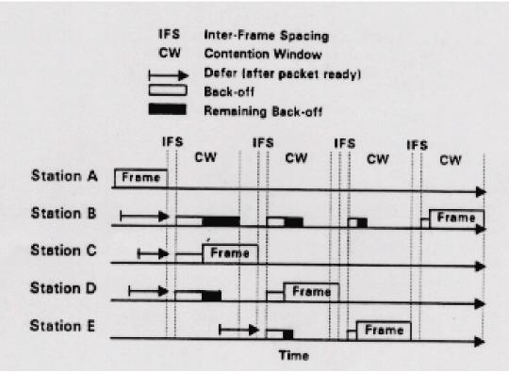
An Example of CSMA/CA
IFS=DIFS

Slide 40
Station A has a frame in the air when stations B, C, and D sense the channel and finds it busy
Each of the three stations will run its random number generator to get a back-off time by random
Station C followed by D and B draws the smallest number
All three terminal persists on sensing the channel and defer their transmission until the transmission of terminal A is completed
After completion, all three terminals wait for the inter-frame spacing (IFS) and start their counters immediately afterward
As soon as C’s backoff timer expires, it starts transmission of its frame

Slide 41
When C starts transmitting, B and D freeze their counters
After C has completed its transmission and another period IFS has elapsed, D and B resumes their counters
D will finish its counter first and starts transmission. Then E and B transmit

Slide 42
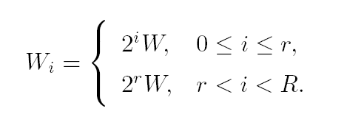
Random Backoff Time
Collison is still possible in CSMA/CA
Backoff time at attempt i = random(0, ) ＊ slot time,
random(0, ) = pseudorandom integer drawn from a uniform distribution over the interval [0, ]
slot time depends on the physical layer characteristics
Binary exponential backoff
W ≤ W_{i} ≤ Wmax
W_{i} takes an initial value of W, and is doubled for every retransmission, until Wmax is reached
where r is the truncation factor and R is the maximum of attempts allowed

Slide 43
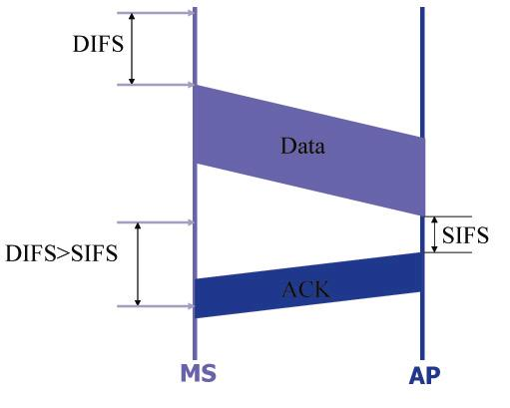
Acknowledgment for MAC Recovery

Slide 44
This is an option in 802.11
When the AP receives a packet of data, it waits for a SIFS and sends the ACK
Since SIFS < DIFS, all other MS must wait until transmission of the ACK to the MS is completed
If this option is not implemented, ACK is left for other layers of protocol

Slide 45
Scheduling

Slide 46
Scheduling for Medium Access Control
Schedule frame transmissions to avoid collision in shared medium
More efficient channel utilization
Less variability in delays
Can provide fairness to stations
Increased computational or procedural complexity
Two main approaches
Reservation
Polling

Slide 47
Reservations Systems
Centralized systems: A central controller accepts requests from stations and issues grants to transmit
Frequency Division Duplex (FDD): Separate frequency bands for uplink & downlink
Time-Division Duplex (TDD): Uplink & downlink time-share the same channel
Distributed systems: Stations implement a decentralized algorithm to determine transmission order
Central
Controller

Slide 48
Reservation Systems
Reservation
interval
Frame
transmissions
r
d
d
d
r
d
d
d
Time
Cycle n
Cycle (n + 1)
r
=
1
2
3
M
Transmissions organized into cycles
Cycle: reservation interval + frame transmissions
Reservation interval has a minislot for each station to request reservations for frame transmissions

Slide 49
Reservation System Options
Centralized or distributed system
Centralized systems: A central controller listens to reservation information, decides order of transmission, issues grants
Distributed systems: Each station determines its slot for transmission from the reservation information
Single or Multiple Frames
Single frame reservation: Only one frame transmission can be reserved within a reservation cycle
Multiple frame reservation: More than one frame transmission can be reserved within a frame
Channelized or Random Access Reservations
Channelized (typically TDMA) reservation: Reservation messages from different stations are multiplexed without any risk of collision
Random access reservation: Each station transmits its reservation message randomly until the message goes through

Slide 50
Example
Initially stations 3 & 5 have reservations to transmit frames
(a)
r
3
5
r
3
5
r
3
5
8
r
3
5
8
r
3
t
Station 8 becomes active and makes reservation
Cycle now also includes frame transmissions from station 8
Reservation may take effect with some delay
(b)
8
r
3
5
r
3
5
r
3
5
8
r
3
5
8
r
3
t

Slide 51
Efficiency of Reservation Systems
Assume minislot duration = vX
TDM single frame reservation scheme
If propagation delay is negligible, a single frame transmission requires (1+v)X seconds
Link is fully loaded when all stations transmit, maximum efficiency is:
TDM k frame reservation scheme
If k frame transmissions can be reserved with a reservation message and if there are M stations, as many as Mk frames can be transmitted in XM(k+v) seconds
Maximum efficiency is:

Slide 52
Random Access Reservation Systems
Large number of light traffic stations
Dedicating a minislot to each station is inefficient
Slotted ALOHA reservation scheme
Stations use slotted Aloha on reservation minislots
On average, each reservation takes at least e minislot attempts
Effective time required for the reservation is 2.71vX
X X(1+ev)
1 1 + 2.71v
ρ_{max} = =

Slide 53
Reservation Systems and Quality of Service
Different applications; different requirements
Immediate transfer for ACK frames
Low-delay transfer & steady bandwidth for voice
High-bandwidth for Web transfers
Reservation provide direct means for QoS
Stations makes requests per frame
Stations can request for persistent transmission access
Centralized controller issues grants
Preferred approach
Decentralized protocol allows stations to determine grants
Protocol must deal with error conditions when requests or grants are lost

Slide 54
Polling Systems
Centralized polling systems: A central controller transmits polling messages to stations according to a certain order
Distributed polling systems: A permit for frame transmission is passed from station to station according to a certain order
A signaling procedure exists for setting up order
Central
Controller

Slide 55
Polling System Options
Service Limits: How much is a station allowed to transmit per poll?
Exhaustive: until station’s data buffer is empty (including new frame arrivals)
Gated: all data in buffer when poll arrives
Frame-Limited: one frame per poll
Time-Limited: up to some maximum time
Priority mechanisms
More bandwidth & lower delay for stations that appear multiple times in the polling list
Issue polls for stations with message of priority k or higher

Slide 56
Walk Time & Cycle Time
Assume polling order is round robin
Time is “wasted” polling stations
Time to prepare & send polling message
Time for station to respond
Walk time: from when a station completes transmission to when next station begins transmission
Cycle time is between consecutive polls of a station
Overhead/cycle = total walk time/cycle time
Polling messages
1
2
3
4
5
…
M
1
2
t
Frame transmissions
Cycle Time

Slide 57
Average Cycle Time
t’
t’
t’
t’
t’
t’
1
2
3
4
5
…
M
1
t
T_{c}
Assume walk times all equal to t’
Exhaustive Service: stations empty their buffers
Cycle time = Mt’ + time to empty M station buffers
λ/M be frame arrival rate at a station
N_{C} average number of frames transmitted from a station
Time to empty one station buffer:
Average Cycle Time:

Slide 58
Efficiency of Polling Systems
Exhaustive Service
Cycle time increases as traffic increases, so delays become very large
Walk time per cycle becomes negligible compared to cycle time:
Can approach 100%
Limited Service
Many applications cannot tolerate extremely long delays
Time or transmissions per station are limited
This limits the cycle time and hence delay
Efficiency of 100% is not possible
Single frame
per poll

Slide 59
Application: Token-Passing Rings
Free Token = Poll
Frame Delimiter is Token
Free = 01111110
Busy = 01111111
token
Ring transmission speed = R bits/s
station
ring interface unit

Slide 60
Station/Ring Interface
Listen mode
Transmit mode
Input
from
ring
Output
to
ring
Delay
Delay
To device
From device
-Ready station looks for free token
-Flips bit to change free token to busy
-Busy token is incorporated as part of
the header of the subsequent transmitted
frame
-Ready station inserts its frames
(exhaustive/non-exhaustive services)
-Reinserts free token when done
-Removes its own frames from the ring

Slide 61
Methods of Token Reinsertion (1/2)
Multi-token operation
Free token transmitted immediately after last bit of data frame
Allows several busy tokens and one free token on the ring at one time
Busy token
Free token
Frame
Idle Fill
frame 1
frame 2
frame 1
frame 1
frame 2
frame 3

Slide 62
Methods of Token Reinsertion (2/2)
Single-token operation
Free token inserted after last bit of the busy token is received back
Transmission time at least ring latency
If frame is longer than ring latency, equivalent to multi-token operation
Single-Frame operation
Free token inserted after transmitting station has received last bit of its frame
Equivalent to attaching trailer equal to ring latency
Busy token
Free token
Frame
Idle Fill

Slide 63
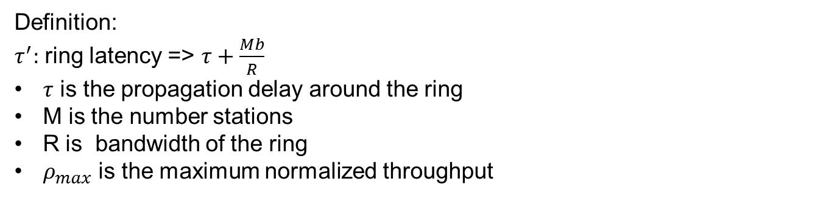

Token Ring Throughput
$$ρ_{max}=\frac{total frame transmission time}{cycle time}$$
Assuming only one frame can be transmitted per token:
Multi-token operation

Slide 64
Token Ring Throughput
Single-token operation
Effective frame transmission time is maximum of X and τ’ , therefore
MX τ΄+ M max{X,τ΄}
1 max{1, a΄} + a΄/M
ρ_{max} = =
Single-frame operation
Effective frame transmission time is X+ τ’ ,therefore
MX τ΄+ M(X+ τ΄)
1 1+a΄(1 + 1/M)
ρ_{max} = =

Slide 65
Token Reinsertion Efficiency Comparison
M = 50
M = 10
Multiple token
operation
M = 50
Maximum throughput
M = 10
Single frame
operation
Single token
operation
a ′
a' <<1, any token reinsertion strategy acceptable
a' ≈1, single token reinsertion strategy acceptable
a' >1, multitoken reinsertion strategy necessary

Slide 66
Application Examples
Single-frame reinsertion
IEEE 802.5 Token Ring LAN @ 4 Mbps
Single token reinsertion
IBM Token Ring @ 4 Mbps
Multitoken reinsertion
IEEE 802.5 and IBM Ring LANs @ 16 Mbps
FDDI Ring @ 50 Mbps
All of these LANs incorporate token priority mechanisms

Slide 67
Comparison of MAC approaches
Aloha & Slotted Aloha
Simple & quick transfer at very low load
Accommodates large number of low-traffic bursty users
Highly variable delay at moderate loads
Efficiency does not depend on a
CSMA-CD
Quick transfer and high efficiency for low delay-bandwidth product
Can accommodate large number of bursty users
Variable and unpredictable delay

Slide 68
Comparison of MAC approaches
Reservation
On-demand transmission of bursty or steady streams
Accommodates large number of low-traffic users with slotted Aloha reservations
Can incorporate QoS
Handles large delay-bandwidth product via delayed grants
Polling
Generalization of time-division multiplexing
Provides fairness through regular access opportunities
Can provide bounds on access delay
Performance deteriorates with large delay-bandwidth product

